Slide 1


Giant Eagle presents:
“Steelers chef of the month”
By Casey McGaw

Slide 2
The Idea
Every month, the Steelers will have a “Steelers Chef of the Month” presented by Giant Eagle, where they take one or two of your favorite players and have them film a “cooking show” style webisode
Recipes can be ones the players pick themselves, or ones fans vote for on social media

Slide 3
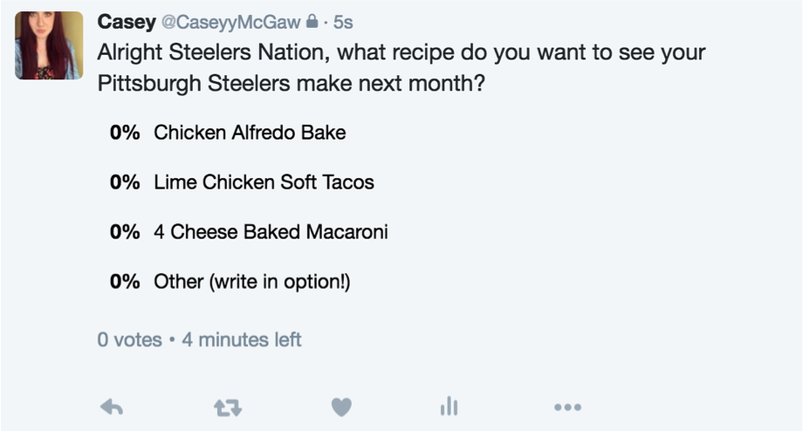


Slide 4



A visual

Slide 5
When should this happen?
The Steelers Chef of the Month video can either happen during the off-season or regular season
Off-Season
  Fans that purchase ingredients from that month’s episode and use their Giant Eagle Advantage Card can earn rewards related to the Steelers’ organization
  Rewards could possibly be discounts for merchandise, terrible towels, something along those lines
Regular Season
  Fans can also earn rewards through Giant Eagle, but in addition Giant Eagle can have a “Steelers Chef of the Month” Stand at Heinz Field during games

Slide 6
Fan Engagement
Heavily engages fans on social media
Fans can potentially vote on social media for different recipe options

