Slide 1

Sponsorship, Naming rights and Endorsement deals
By Casey McGaw

Slide 2

About Elio
Founded by Paul Elio in 2009, based in Phoenix, AZ
Innovative, all-American vehicle created by Paul Elio
Three wheels, two tandem seats
$7,300 starting price
84 MPG on the highway, 49 MPG city
Goals of Elio Motor vehicles are to be low cost, fuel efficient, American made, and engineered to meet the industry’s highest safety standards.

Slide 3
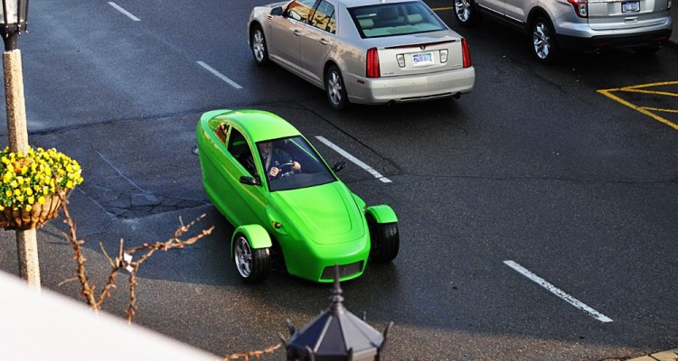
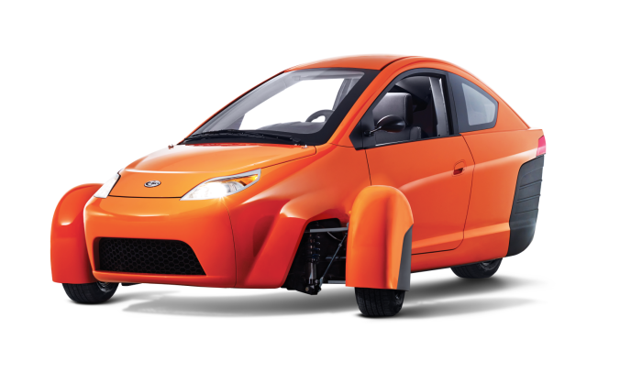
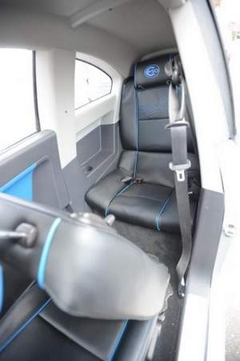
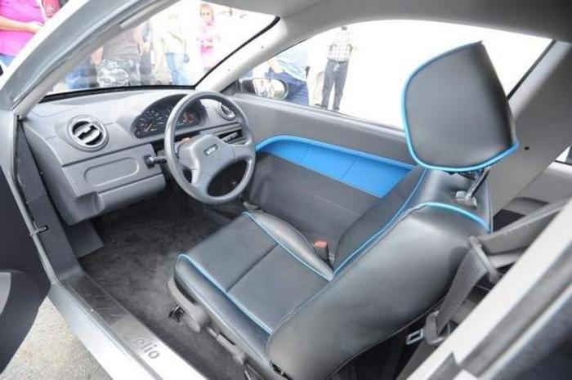

Slide 4
Elio Motors target markets
“And” buyers – consumers who want to keep the utility of their SUV, AND own an Elio for solo commutes
New car buyers
First-time buyers
College students
People looking to replace “clunkers”

Slide 5


SPONSORSHIPS
Elio Motors will become a sponsor of the Vans Warped Tour, with two major activations on site during the festival
Elio Motors Stage
Elio Motors Wi-Fi Lounge
And the

Slide 6
And the
Elio Motors Stage
Elio Motors will sponsor 1 of 9 Warped Tour stages
Middle tier stage (non-headlining acts)
BANNER/BACK DROP
F
L
A
G
F
L
A
G

Slide 7
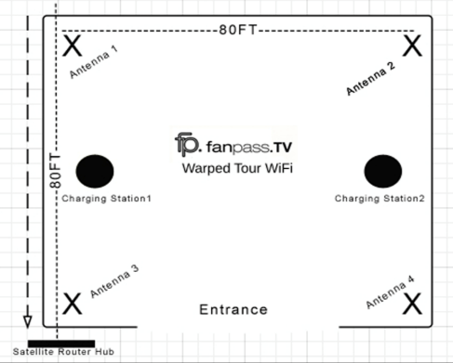
And the
Elio Motors Wi-Fi Lounge
Elio Motors will be the brand behind the Official Warped Tour Wi-Fi Lounge
Free connection for up to 1,000 people
2-4 branded charging stations
Digital assets on Wi-Fi landing page
Banner signage in the tent and outside as well
Information flyers on tables in tent

Slide 8
And the
Vans Warped Tour puts on 42 shows in 52 days
Avg. daily attendance is 13,568
Total attendance in 2014 was 569,865 people
52% of Vans Warped Tour attendees are 18-25 years old
98% of fans take home everything they get at the festival (fliers for example)
86.2% of fans are likely to purchase or try a sponsor’s product due to their association with Warped Tour
A good portion of our target market matches with the Warped Tour Market, and we believe these sponsorships will provide a good ROI.

Slide 9
NAMING RIGHTS
Elio Motors Convention Center
Located in Tucson, Arizona
Originally called the Tucson Convention Center
Multi-purpose facility – three main areas
  Tucson Music Hall – 2,289 seats
  Leo Rich Theatre – 511 seats
  Tucson Arena – 4,988 seats
Home to AZ Coyotes’ AHL affiliate, Tucson Roadrunners and University of Arizona Wildcats Ice Hockey team

Slide 10
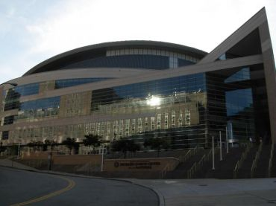
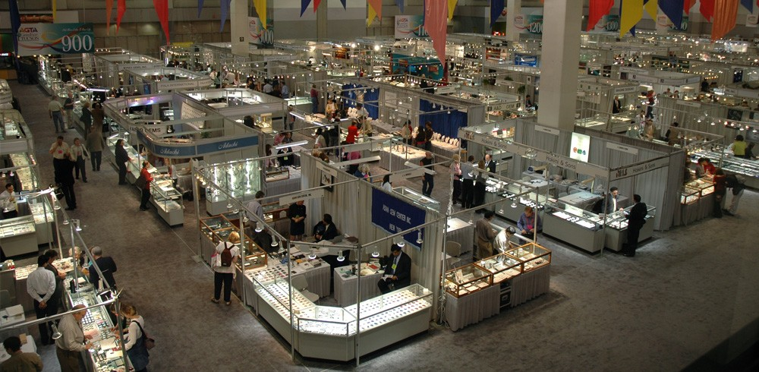
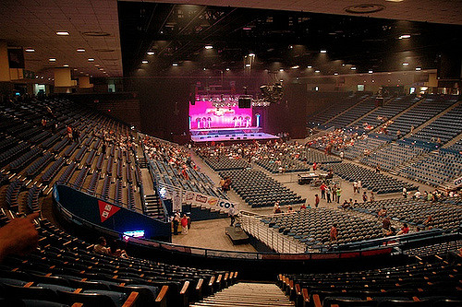
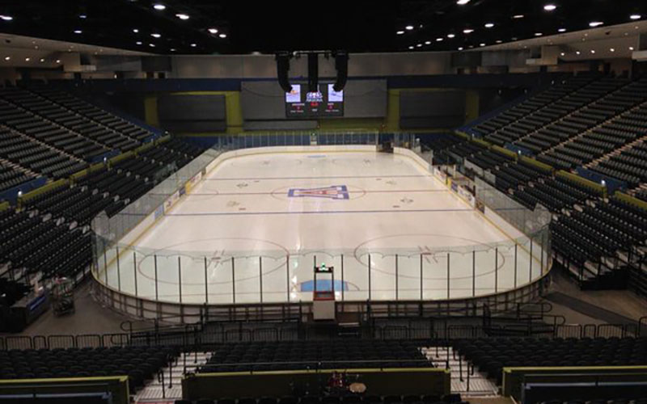

Slide 11
NAMING RIGHTS – Why
Elio Motors headquartered in Phoenix, 2 hours from Tucson
Newer company, so we didn’t want to go for a huge arena.
Convention Center still provides lots of traffic and exposure to everyone one of our target market segments
Opportunities for exposure in the community, and in the venue
  In-venue signage
  Web content & social media
  Advertising
  Ticketing
  Brand exposure during hockey games

Slide 12
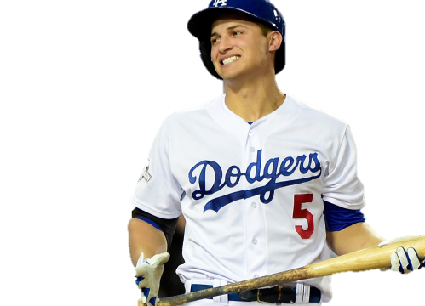
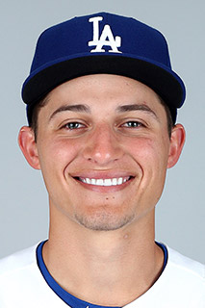
CELEBRITY ENDORSEMENT
Corey Seager
Short Stop, Los Angeles Dodgers

Slide 13
and Corey Seager
High Achiever:
  1st Round draft pick
  2016 NL Rookie of the year, Silver Slugger award winner
  Youngest MLB SS to hit 3 home runs in a game
  Became youngest Dodger to hit a post-season HR
  Hit .130 w/ two HRs in NLDS, and .286 in the NLCS
  Ruined rival team Giants pitcher’s no-hitter in the last out of the 9th inning once
Believability and credibility:
  Proven himself to be hard working and successful
AVG | HR | RBI | SB | OPS
.312 | 30 | 89 | 5 | .892

Slide 14
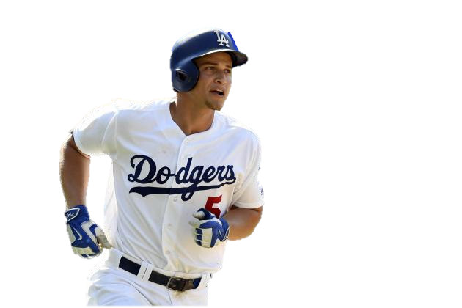
and Corey Seager
Well known:
  His awards and success throughout the season and post-season make him well known not only to Dodgers fans, but baseball fans everywhere
  Los Angeles is a big market
Physical attractiveness:
  I’d say a solid 6.5 to 7 of 10

Slide 15
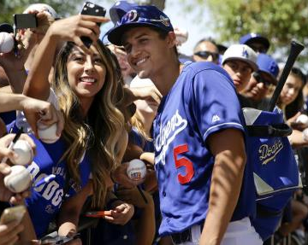
and Corey Seager
Likeable and admired:
  No matter who you are, it’s hard to root against a young kid with this much success
  Seemingly always happy and willing to interact with fans
  Has received praise from other baseball greats –
    Adrian Gonzalez suggested he could one day reach the HOF
    Don Mattingly compared him to his own hero, Derek Jeter

Slide 16
and Corey Seager
Target Market Match:
  Corey Seager is a good match for Elio Motors because like our company he is new and exciting (just like our vehicles). These are two qualities we want to associate with our vehicles
  Our target market segments can heavily match those of Baseball fans – first time buyers, college students, buyers looking to add an additional vehicle
  His young age can make him especially appealing to our younger buyers
  Overexposure:
    Doesn’t currently have many endorsements, which leaves lots of opportunity, especially before he plays again and gets even better and progresses in his career

Slide 17

THE END

